Slide 1
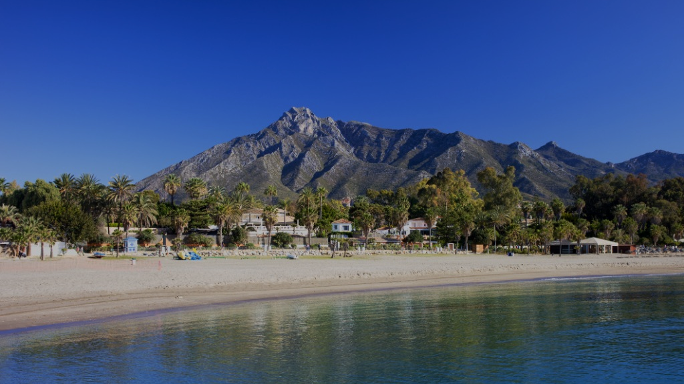
ESSENCE OF
ANDALUCIA
5 NIGHTS INCENTIVE PROGRAM

Slide 2
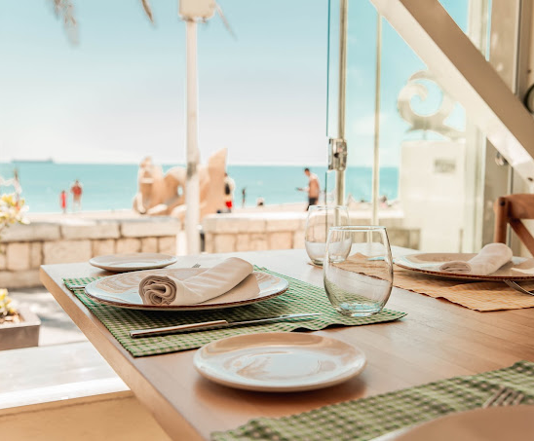
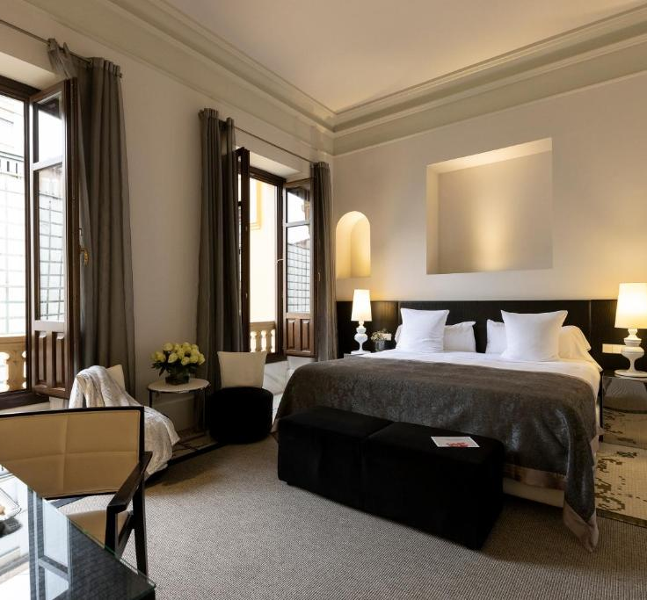
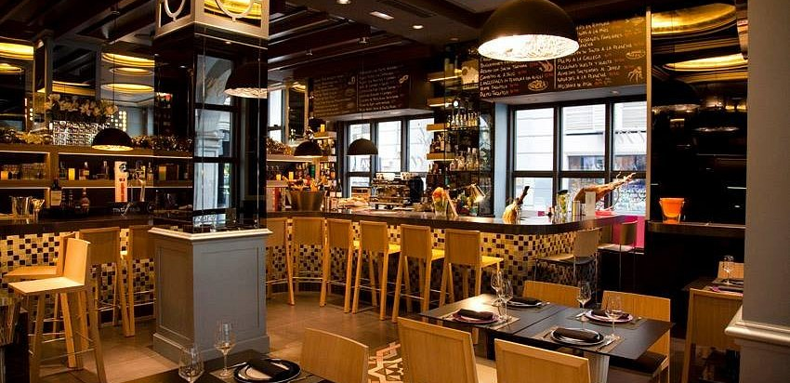
DAY 1 Welcome to Andalusia!
Upon arrival at Málaga Airport, you will be greeted and taken on a short panoramic tour of the vibrant coastal city.
To unwind from your journey, enjoy a Mediterranean welcome lunch by the seaside, soaking in the fresh sea breeze.
In the afternoon, we will head to Granada, where you will check in at your hotel.
In the evening, delight in an exclusive gastronomic wine-pairing dinner in the charming old streets of Granada, immersing yourself in the city's rich culinary traditions
Overnight in a luxury hotel in Granada

Slide 3
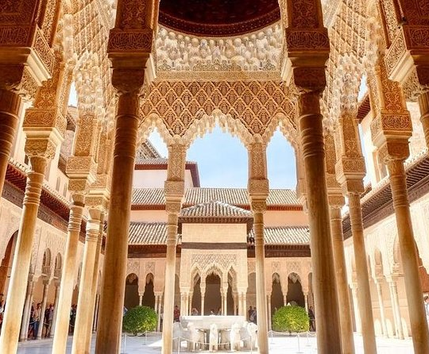
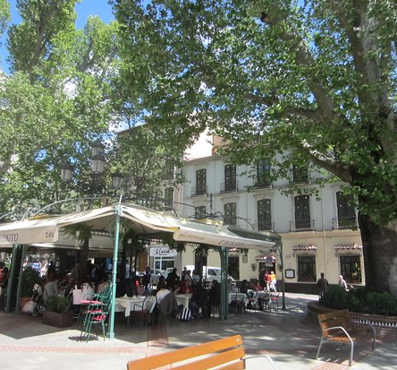
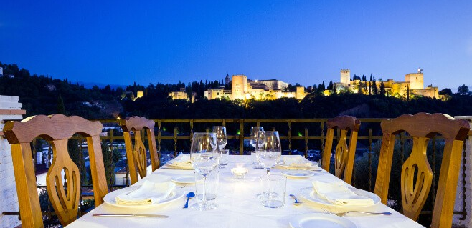
DAY 2 Enchanting Alhambra & Granada’s Hidden Gems
Start the day with a full guided tour of the Alhambra & Generalife, where expert guides will unveil the secrets of Andalusia’s most treasured historic jewel.
After this captivating experience, we return to the bustling city center for a lunch in a typical restaurant frequented by locals. A short guided walking tour will introduce you to the heart of Granada.
As evening falls, we ascend to the picturesque Albaicín quarters for a gastronomic dinner with live Spanish guitar music, offering breathtaking views of the illuminated Alhambra.

Slide 4
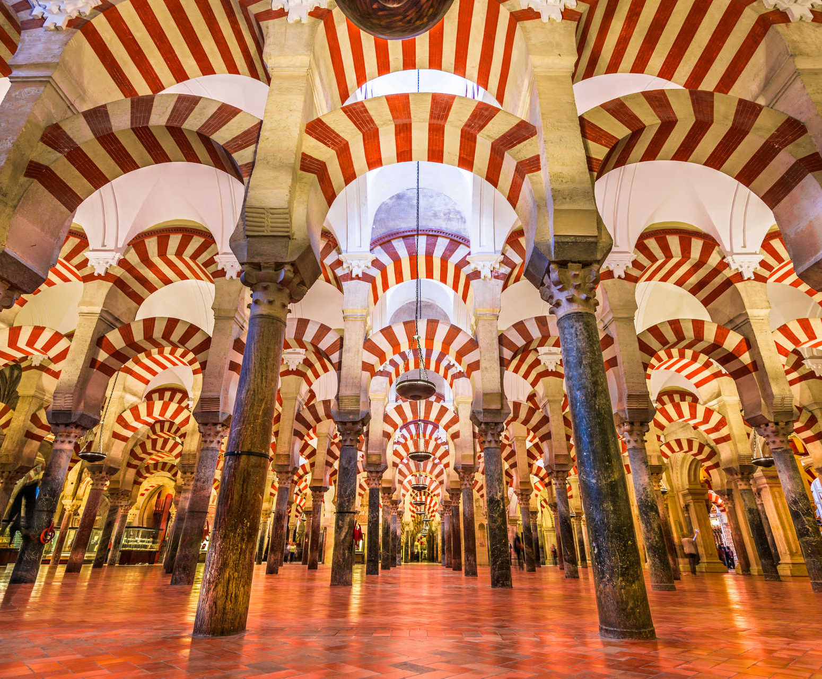
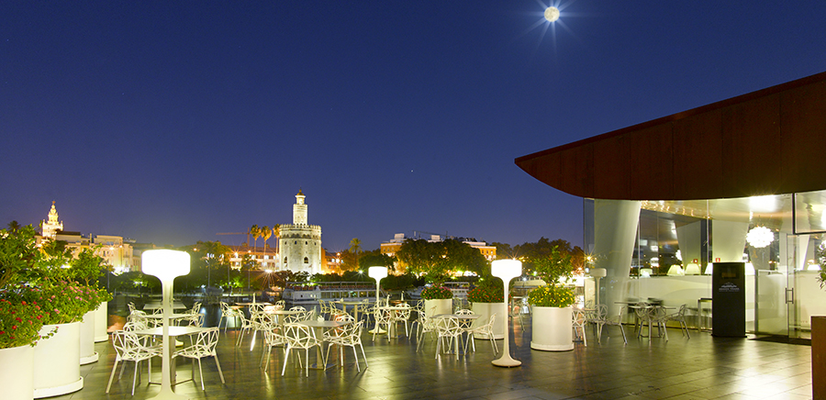
DAY 3: Córdoba - The Legacy of Three Cultures
We embark on a journey to Seville, making a special stop in Córdoba to explore the world-famous Mezquita, a stunning blend of Islamic and Christian architecture, featuring a vast forest of red-and-white striped arches. Originally built as a mosque, it now serves as a cathedral, symbolizing the city's rich multicultural heritage
Stroll through the enchanting Jewish Quarter before indulging in a fine Andalusian lunch, featuring local delicacies such as Salmorejo Cordobés and crispy fried aubergines.
Upon arrival in Seville, check in and enjoy some free time to relax before an elegant dinner along the Guadalquivir riverside, where the city’s charm comes to life at night.

Slide 5
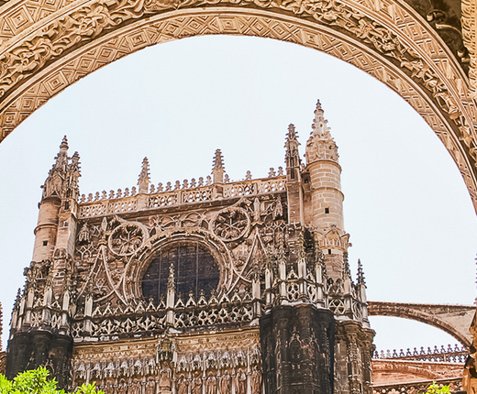
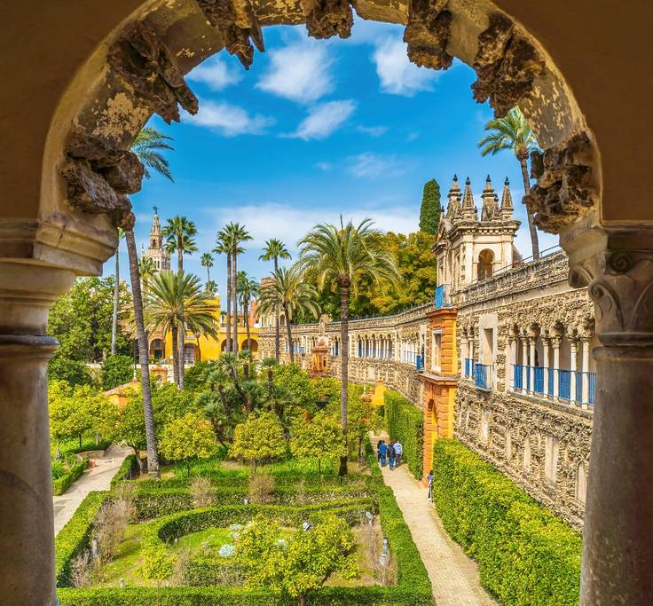
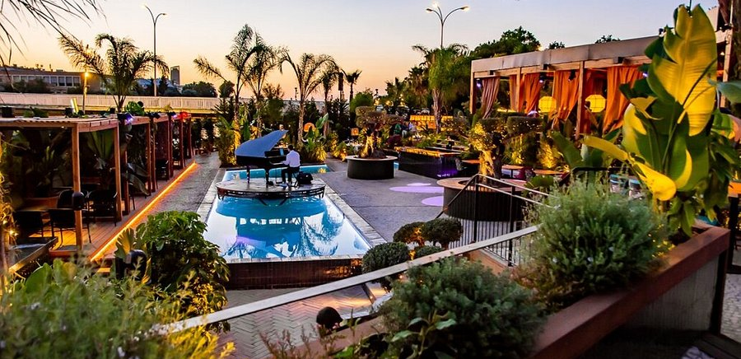
DAY 4 Sevillan History, Passion, and Elegance
Today, discover Seville’s grand historic legacy with guided visit to the Cathedral, symbol of Gothic grandeur and home to the tomb of Christopher Columbus, its Giralda and breathtaking views upon the city and the Alcázar with its Moorish beauty, lush gardens, and intricate architectural details
. After a delightful traditional lunch, horse-drawn carriages will transport you back to the hotel in true Andalusian style.
The evening will be a celebration of Seville’s modern sophistication, with dinner at an exclusive venue featuring outdoor space, live entertainment, and a vibrant atmosphere, where we will savor reimagined Mediterranean delicacies.

Slide 6
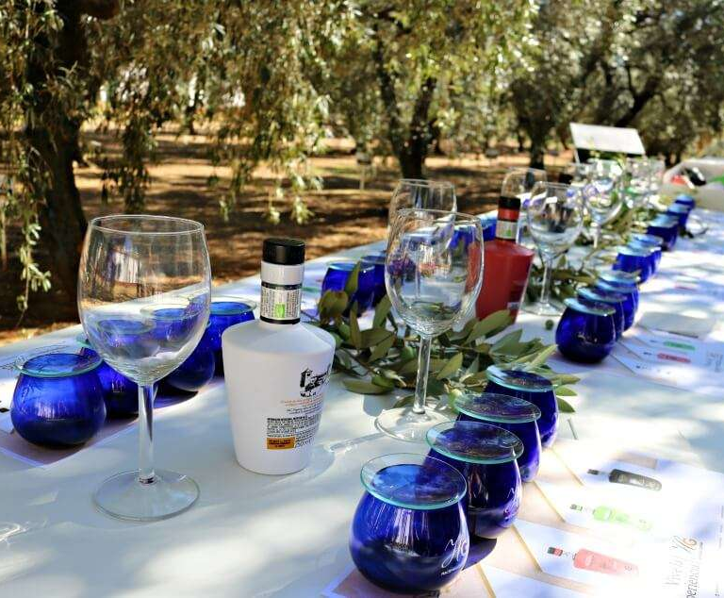
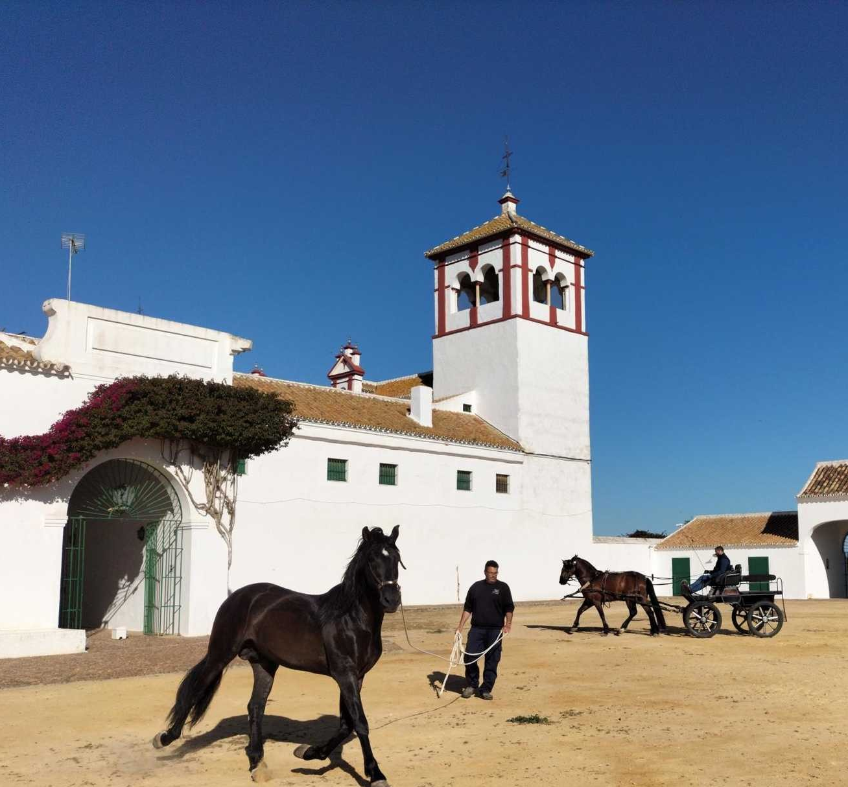
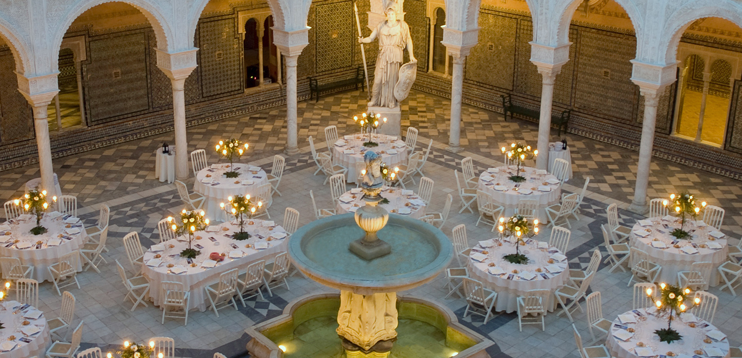
DAY 5: Taste of Tradition - Olive Oil, Andalusian Horses & Flamenco Passion
Escape to a traditional Andalusian finca, where you will uncover the secrets of local olive oil production. Experience a guided tasting of premium olive oils and Iberian ham, followed by a delightful tapas lunch in the finca’s charming patio.
The afternoon brings an exquisite Andalusian equestrian performance, showcasing the elegance of the region’s famous dancing horses.
For our grand finale, we step into a private Sevillian mansion for a gala dinner, where an exclusive flamenco show will ignite the night with passion, rhythm, and unforgettable energy.

Slide 7
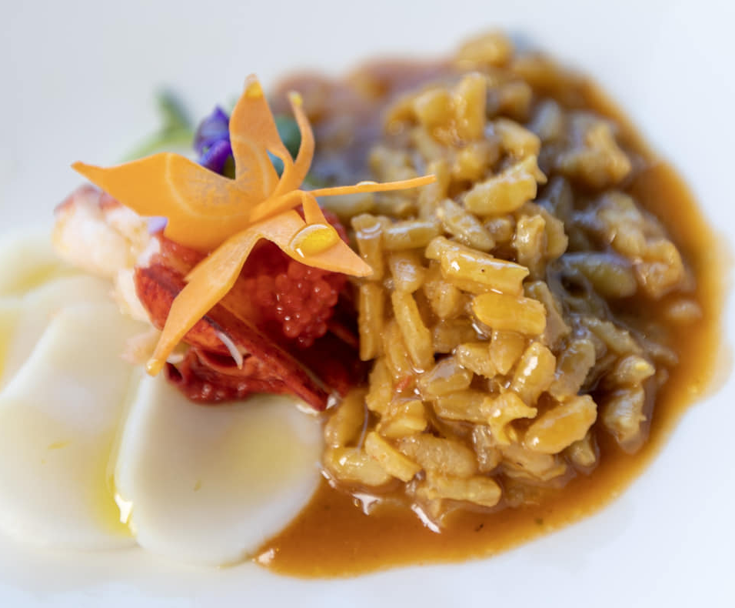
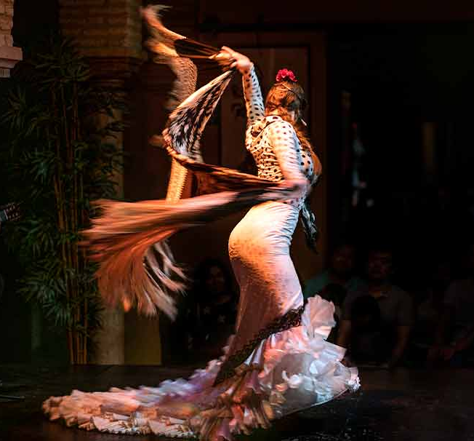
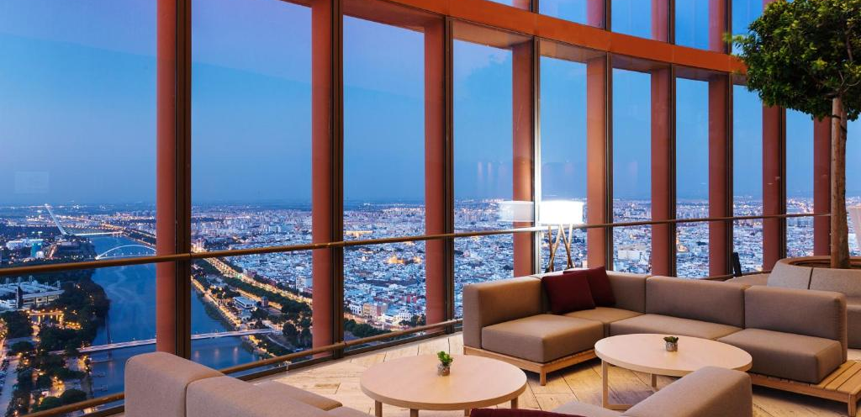
DAY 4: Hasta Pronto!
Breakfast, check out & transfer to the airport
Tell us about your project and we will discuss the best options for your event, according to your budget and special needs.

